Slide 1


UN environment
Economy-Wide
Material Flow Accounting
Webinar #2
Dr. Nina Eisenmenger, Institute of Social Ecology, University Klagenfurt
Dr. Stephan Lutter, Institute for Ecological Economics, Vienna University of Economics and Business
in cooperation with CSIRO and Nagoya University
November 13, 2017

Slide 2
Program
Webinar #1 (90 minutes)
  MFA, SDGs and UN Environment engagement
  Purpose and use of material flow accounts
    Concept, methods, indicators
  Practical application of material flow accounts
    Domestic Extraction
Webinar #2 (90 minutes)
  Practical application of material flow accounts
    Domestic Extraction, trade, waste and emissions
    Material footprints and material stock accounts
    Specific issues according to country requirements
  Outlook towards the country visit and
  expectation for the collaboration with ONS

Slide 3
Domestic Extraction and trade
Data sources

Slide 4
Data sources
National data useful for MFA compilation:
  Agricultural statistics, forest inventories, fishery statistics
  Mining surveys
  Production statistics
  Foreign trade statistics
Use national statistical data that is compiled to fulfil reporting obligations to international bodies:
  FAO → biomass DE and trade
  IEA → fossil fuels DE and trade
  UN Comtrade
Please note!
Production statistics report the products which are sold on the market
DE does not refer to a market transaction but to the act of extraction of natural resources from the natural environment.

Slide 5
DE biomass

Slide 6
DE Biomass – MFA structure
Residual biomass from crop harvest
Extraction from grassland: mown grass (incl. hey), grazed biomass
A.1 Biomass
 | A.1.1 Primary crops
 |  | A.1.1.1 | Cereals
 |  |  | A.1.1.1.1 Rice
 |  |  | A.1.1.1.2 Wheat
 |  |  | A.1.1.1.3 Cereals n.e.c.
 |  | A.1.1.2 | Roots, tubers
 |  | A.1.1.3 | Sugar crops
 |  | A.1.1.4 | Pulses
 |  | A.1.1.5 | Nuts
 |  | A.1.1.6 | Oil bearing crops
 |  | A.1.1.7 | Vegetables
 |  | A.1.1.8 | Fruits
 |  | A.1.1.9 | Fibres
 |  | A.1.1.10 | Other crops
 |  |  | A.1.1.10.1 Spice, beverage, pharmaceutical crops
 |  |  | A.1.1.10.2 Tobacco
 | A.1.2 Crop residues (used), fodder crops, grazed biomass
 |  | A.1.2.1 | Straw
 |  | A.1.2.2 | Other crop residues (sugar and fodder beet leaves, other)
 |  | A.1.2.3 | Fodder crops (incl. harvest from grassland)
 |  | A.1.2.4 | Grazed biomass
 | A.1.3 Wood
 |  | A.1.3.1 | Timber (industrial roundwood)
 |  | A.1.3.2 | Wood fuel and other extraction
 | A.1.4 Wild harvest n.e.c.
 |  | A.1.4.1 | Wild fish catch
 |  | A.1.4.2 | All other wild aquatic animals catch
 |  | A.1.4.3 | Wild aquatic plant harvest
 |  | A.1.4.4 | Wild terrestrial plant harvest n.e.c. (incl. gathering)
 |  | A.1.4.5 | Wild terrestrial animal catch (incl. hunting)
Crops from …
arable land
(cereals, vegetables, fibres, etc.)
permanent cultures
(fruits, nuts, wine)
Timber from cultivated and non-cultivated forests (including bark)
Fire wood (incl. gathering of fire wood)
Other forestry products (forest litter, cork, natural rubber)
Aquatic:
fish capture (including recreational fishing)
other animals/plants
extracted from unmanaged fresh and seawater systems
Terrestrial:
Gathered wild terrestrial plants (mushrooms, berries etc.)
Hunted wild terrestrial animals

Slide 7
system boundary issues
Crops: DE follows the harvest approach as against the ecosystem approach
Wood: SEEA accounts: memorandum item “net-increment of timber stock”,
i.e. natural growth of cultivated timber
Fishery
  DE = (wild) fish catch and other aquatic animals a. plants;
  → no DE: fish from aquaculture (socio-economic stock)
Hunting and Gathering
  DE = hunting of wild animals;
  → no DE: animals from animal husbandry (socio-economic stock)
  DE = honey from wild bees;
  → no DE: honey from beehives (socio-economic stock)
Animal products in MFA
  Domestic animals (livestock) are considered socio-economic stocks → animal feed is an input (DE) → animal products (milk, eggs, meat, etc.) are derived products, i.e. internal flows within the socio-economic system and NOT accounted for as DE

Slide 8
Specific issues
Moisture content
  The moisture content is variable across plant parts and species and vegetation periods; and biomass might also be dried during the harvesting process (e.g., hay making).
  biomass accounted for at its “as is weight” at the time of harvest (in accordance w. agric.stats)
  fodder crops, grazed biomass, wood: standardized moisture content of 15% (MFA convention)
Wood
  conversion from volume (solid cubic meters) to weight (tons)
  (according to tree species, i.e. coniferous and non-coniferous)
  Inclusion of bark (accounts for approximately 10% of stem wood weight): wood felling is mostly reported in solid cubic meters (m3) under bark (i.e. without bark)
Biomass waste from management
  Biomass waste from management of parks, infrastructure areas, gardens (mown grass, woody biomass, residues from pruning, foliage etc.) may be further used, e.g. for energy generation
  Conceptually included in DE (and DPO), but
  no standardized reporting; therefore mostly not considered.
Draw on local
expert knowledge

Slide 9
Data sources
Data sources generally cover:
the harvest of all types of crops (A.1.1) and wood (A.1.3), and biomass extraction by fishing (A.1.4.1) and hunting activities (A.1.4.5).
In some cases crop residues (A.1.2.1 and A.1.2.2), harvested fodder crops and biomass harvested from grassland (A.1.2.3).
Usually not estimated by official statistics is grazed biomass (A.1.2.4). However, these items are of high quantitative significance, so we have to apply estimation procedures.
Data sources:
Primary data source: national agricultural, forestry, and fishery statistics
Other national data source: national feed-, food- and wood-balances,
Economic Accounts for Agriculture EAA, Agric. land use statistics FSS, National Production Statistics
International data source:
UN Food and Agricultural Organisation (FAO)

Slide 10
A.1.1 primary crops – FAO data
Crops | South Africa | production quantity

Slide 11
A.1.2.1 & A.1.2.2 crop residues used
Crop residues are residual biomass from crop harvest
(such as straw and leaves)
which are subject to further socio-economic use
(such as bedding material, feed, energy production, or in industrial processes).
Residues which are left in the field and ploughed into the soil or burned in the field are not accounted for as DE
Calculated by using harvest factor & recovery rate.
  Available crop residues = primary crop harvest * harvest factor
  Used crop-residues = available crop-residues * recovery rate

Slide 12
A.1.2.3 fodder crops
Fooder crops incl. harvest from grassland (e.g. hey)
Animal fodder is a mixture of different types of roughage, i.e. fodder crops, biomass harvested from grassland, and biomass directly grazed by livestock.
  Coverage of these large flows in agricultural statistics is usually poor.
  The three components have to mutually balanced in a grazing gap calculation
Fodder crops includes maize for silage, grass type and leguminous fodder crops (clover, alfalfa etc.), fodder beets and also mown grass harvested from meadows for silage or hay production.
All commercial feed crops such as barley, maize, soy bean etc. are not included in this category, but are accounted for under A.1.1 crops.
For some countries national feed balances exist from which data on fodder crops, biomass harvested from grassland, and grazed biomass can be derived.
A standardized moisture content of 15% has to be applied

Slide 13
A.1.2.4 grazed biomass
(A) Estimation based on roughage intake per head
  roughage requirement = livestock heads * annual feed intake
  Note: daily intake depends on the age and live weight of the animal, animal productivity (e.g., weight gain, milk yield), and the feeding system (e.g., feed composition) → may vary considerably within one species depending on the livestock production systems.
  demand for grazed biomass = roughage requirement – fodder crops
(B) Estimation based on feed conversion efficiency
  Calculation based on data on primary animal products (e.g. meat and milk)
  and appropriate feed conversion coefficients (feed demand per unit of product)
  feed requirement = product * feed conversion coefficient
  Note: this method does not consider cattle and buffalo which are used primarily to provide draught power. The feed demand to provide these services will not be accounted for with this method.
  roughage demand = feed requirement * share of roughage
  demand for grazed biomass = roughage requirement – fodder crops
  The roughage demand of horses, mules and asses and other grazing animals has to be calculated applying method A
  A similar but more complex version of (B) is applied in the UN MFA database

Slide 14
DE fossil energy carriers

Slide 15
A.4 Fossil fuels – general approach
Energy statistics and energy balances - to the International Energy Agency (IEA) - provide comprehensive illustration of supply and use of all energy carriers.
In EW-MFA the domestic extraction of energy materials/carriers limited to extraction of fossil energy carriers
Primary renewable energy carriers, such as hydro, wind, solar and geothermal energy not included
materials required to construct e.g. hydropower dams, wind turbines or solar panels are considered in metal or mineral accounts
Biomass for energy purposes reported under biomass.
Uranium reported under metals

Slide 16
A.4 Fossil fuels – structure of MFA account
Brown coal | A.4.1.1.1 | Lignite (brown coal)
 | A.4.1.1.2 | Other sub-bituminous coal
Hard coal | A.4.1.2.1 | Anthracite
 | A.4.1.2.1 | Coking coal
 | A.4.1.2.3 | Other bituminous coal
Peat | A.4.1.3
Crude oil, condensate and natural gas liquids | A.4.2.1 | Crude oil
 | A.4.2.2 | Natural gas
 | A.4.2.3 | Natural gas liquids
Oil shale and tar sands | A.4.3

Slide 17
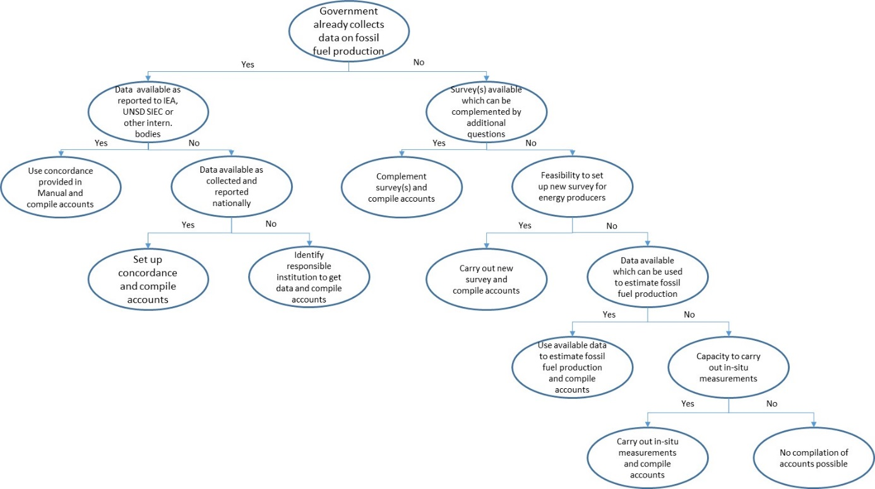
A.4 Fossil fuels – data availability

Slide 18
A.4 Fossil fuels –
MFA vs. IEA or UNSD specifications
Detailed data required for this purpose far exceeds what is necessary for high quality MFA accounts
Yields a lot of valuable information about the structure of one of the most crucial aspects of your economy
Is well supported by the agencies involved in terms of providing questionnaires and manuals
Use data reported to IEA/UNSD → bridge table in manual
Begin reporting to one of these agencies

Slide 19
A.4 Fossil fuels – data sources
Data source | Characteristics
Administrative data | Derived from an administrative source, that is, by an “organizational unit responsible for implementing an administrative regulation (or group of regulations) for which the corresponding register of units and the transactions are viewed as a source of statistical data”
Statistical surveys | Sample surveys and censuses
Modelling | Estimation of a variable/data item which cannot be measured directly, but is estimated based on measurable and observable data
In situ measurements | Techniques to collect detailed consumption data based on a measuring device which, for example, can be installed at the point of final consumption

Slide 20
A.4 Fossil fuels – data sources
Data collection method | Data sources | Potential data observed
administrative data | data owners | coal production crude oil production natural gas production
census/sample survey | entities in the mining industry (coal, oil, gas)

Slide 21
A.4 Fossil fuels – special cases
Natural gas:
Often reported in volume or energy content (“gross calorific value”, GCV)
For conversion into metric tonnes ideally apply region specific factors
Where no such data are available, average factors can be applied
kg / m³ (standard cubic metre at 15 °C) | GCV [MJ/kg] | GCV [MJ/m³]
0.8 | 50 | 40

Slide 22
DE metal ores

Slide 23
A.2 Metal ores and M.2 Metal content – general approach
For EW-MFA purposes, only that portion of the excavated rock should be counted, which is to be processed in some way, to obtain the desired metals.
Any soil or rock which is simply excavated and moved, to gain access to the metal ore itself, should not be counted as ore (overburden and non processed rock)
Typically, great majority (often a ratio > 3:1) of excavated soil and rock not counted at all as part of EW-MFA
Often, ores from same deposit processed in different ways, depending on metal content and the specific metallurgical characteristics of the ore.
Example: high grade copper ores go directly into milling and flotation process, while low grade ores go to a “heap leaching” process. Both should be counted as mined ore.
EW-MFA: accounting on a “run of mine” (ROM) basis

Slide 24
A.2 Metal ores and M.2 Metal content – structure of MFA accounts
Iron ores | A.2.1
Aluminium ores | A.2.2
Other metal ores | A.2.3
Metal content | M.2.Ag | Contained silver
 | M.2.Al | Contained Aluminium
 | M.2.Au | Contained Gold
 | …… | …..
 | M.2.Cu | Contained Copper
 | …. | …..
 | M.2.Fe | Contained Iron
 | …. M.2.x | …..Contained x where x ix a metallic element
 | …. | …..
 | M.2.Zn | Contained Zinc
Notes:
The preferred method of Compiling Metal ores accounts has changed a lot from the Eurostat guide.
One big change has been the lumping together of all gross ores other than Iron and Aluminium under Other metal ores. Previously went by individual metals.
Another important change is the upgrading of contained metals from optional to compulsory. This both more reflective of the reality of available data, and compensates for the lack of detail in the ore categories.
Note that while contained metals are compulsory, they are not added to metal ores, for material flow totals, as this would be double counting.

Slide 25
A.2 Metal ores and M.2 Metal content – specificities
Unlike fossil fuels and biomass, no one international agency charged with assembling data DE data (nearest things are USGS and BGS).
Multiple basic products from same initial extraction very common – cereal plants produce one specific cereal, but mixed ores product multiple different metals
Relationship between the product usually reported, and the ore initially extracted varies hugely, making back calculation highly inaccurate.
Unlike some other difficult materials e.g. grass eaten by cattle, the data necessary usually is closely measured, as part of operations, by limited number of relatively large operations.
The preferred approach being piloted here is a large departure form previous practice in EW-MFA manuals

Slide 26
A.2 Metal ores and M.2 Metal content – accounting approaches
Two alternative systems being proposed.
Operator questionnaire based (the preferred method)
  Advantages: Conceptually straight forward, preserves a lot of data with practical policy and resource management uses beyond EW-MFA.
  Disadvantages: Requires access to summarized operational data from mine operators, or at least an ability to produce something similar from accessible data.
Secondary mixed source (fall-back method)
  Advantages: Flexible, data requirements much less prescriptive, usually possible to construct account of some type.
  Disadvantages: Subject to much larger error, data produced mainly indirect, based on many assumptions (and potentially misleading), limited value beyond EW-MFA.

Slide 27
A.2 Metal ores and M.2 Metal content – mining operator questionnaire based

Slide 28
A.2 Metal ores and M.2 Metal content – secondary mixed source
Find and refer to relevant national authority charged with licensing and oversight of mining operations
Ascertain what level of reporting of minerals production is mandated.
Maybe more than one government authority holding relevant information, e.g. departments of mining, primary resources, environment etc.
In some cases, detailed data on quantity and characteristics of ore mined required on an annual basis by all mining operators
In other cases, little reporting on the physical outputs of mining required, rather only financial reporting required

Slide 29
A.2 Metal ores and M.2 Metal content – secondary mixed source
Proxy data where a royalties / resource rental tax regime applies.
  royalty system uses a set payment per tonne of ore extracted
  information held by national or state/provincial taxation offices, or by department responsible for administration of mining activities.
Company reports
  considerable detail on production of ore, tonnages of metal produced
  extent, quality and utility of the data obtained from such reports vary
  dependent on corporate reporting standards required in each individual jurisdiction
Often, volumetric output of mining industry dominated by small number of large operations
  Possible to produce good estimate of national domestic extraction of metal ores from relatively few individual company reports
  Possible to build a reasonable estimate of metal ores extraction from searching unofficial online sources

Slide 30
A.2 Metal ores and M.2 Metal content – specificities
Ore grades – source of errors
Data reported only in metal content
Using default/average ore grades, such as those provided in Eurostat’s manual (2013), to back-calculate extracted ore
  Poor grade information can create such large errors that, for this manual, no default grades are provided for back-calculation of ore tonnages. This is to ensure that at least some local knowledge is used in their determination.
Metal prices
back-calculate metal production from data on the value of sales
prices can be highly volatile
unless good estimates of the average prices received for metals are available, it may be better not to employ this method at all

Slide 31
DE non-metallic minerals

Slide 32
DE non-met.min. –
MFA structure
A.3 Non-metallic minerals
 | A.3.1 Ornamental or building stone
 | A.3.2 Chalk and dolomite
 |  | A.3.2.1 | Chalk
 |  | A.3.2.2 | Dolomite
 |  | A.3.2.3 | Limestone
 | A.3.3 N/A
 | A.3.4 Chemical and fertilizer minerals
 |  | A.3.4.1 | Fertilizer minerals n.e.c.
 |  | A.3.4.2 | Chemical minerals n.e.c.
 |  | A.3.4.3 | Industrial minerals n.e.c
 | A.3.5 Salt
 | A.3.6 Gypsum and limestone
 | A.3.7 Clays
 |  | A.3.7.1 | Structural clays
 |  |  | Specialty clays
 | A.3.8 Sand and Gravel
 |  | A.3.8.1 | Industrial sand and gravel
 |  | A.3.8.2 | Sand gravel and crushed rock for construction
 | A.3.9 Other non-metallic minerals n.e.c.
Limestone:
limestone used for industrial purposes (e.g. production of lime or cement)
→ A.3.6 (gypsum and limestone) → bulk flows, often underreported
crushed limestone aggregate → A.3.8 (sand and gravel)
limestone as a dimension stone → A.3.1 (ornamental or building stone).

Slide 33
DE non-met.min. – specific issues
Large and dynamic flows, closely linked to economic growth and industrialization
Majority of non-metallic minerals are used for construction purposes
  sand, gravel, building stones, clays
Bulk flows: widely available throughout the world; low price, large volumes → usually not sufficiently covered in official statistics
In some cases, these materials are used without any further mechanical, thermal, or chemical processes (e.g. sand & gravel for road bedding)
Industrial uses and uses for construction purposes (e.g. clays, sand, limestone)
  industrial uses: well-covered in statistical reporting
  uses for construction: mostly underreported

Slide 34
Data sources
National data sources:
  national mining surveys
  Production statistics
  Please note!
    Production statistics report the products which are sold on the market
    DE does not refer to a market transaction but to the act of extraction of natural resources from the natural environment.
International data sources:
  USGS United States Geological Survey
  BGS British Geological Survey
  World Mining Data

Slide 35
Conversions and estimations
The run-of-mine approach principally also holds true for non-metallic minerals. However, the difference between run-of-mine production and reported production is considered not relevant.
Minerals have specific moisture content that is usually not subject to high variability. In a first and simple approach, data for the extraction of minerals can be taken as they are reported.
Sometimes, data are reported in cubic meters. In those cases, a conversion to tons is required by using specific gravity coefficients (densities in kg/m³)
Bulk flows of non-metallic minerals are usually weakly covered in statistical reporting (high volume low price relations) → estimation.
  As a rule of thumb: a DE of non-met. minerals of below 1 t/cap
  (more specifically see Manual) is very low (too low).
  An estimation of bulk flows is recommended!

Slide 36
Estimation of bulk flows
Limestone for cement production
  limestone required in production of Portland cement: cement production * 1.216
  Note: also dolomite is used for cement production! Cross check to avoid double counting!
Sand & gravel (S&G): sum of 4 sub-calculations:
  S&G input to produce cement: cement apparent consumption * 5.26
  S&G for road layers → based on length of newly built roads (by type of road and year) and annual maintenance of the total existing kilometers of roads.
  S&G as ballast under train tracks per km of railway
  S&G for building road sublayers: extremely complicated, variability in soil composition, groundwater depth, weather, typical construction methods, average building loads.
  S&G from cement consumption * 0.08
Clays: conversion factors to tons of crude clay for
clay products (e.g. bricks, tiles)

Slide 37
Specific issues
Crushed rock
  “Broken natural stones for road-, railway-, waterway-, and building”, reported by some statistical sources
  “Crushed rock” is not defined by material characteristics
  → may be A.3.2 (chalk and dolomite), A.3.6 (limestone and gypsum), A.3.8 (sand and gravel), A.3.9 (other non-metallic minerals n.e.c.), or also sandstone, volcanic stones, basalt, granite, quartzite, gneiss...
  Cross-check for overlaps and double-counting
Excavated soils
  A.3.10 Excavated earthen materials (including soil), only if used
  Difficult category, mostly not reported, or if then at weak data quality
  May be of significant size
  Important, if covered in DPO

Slide 38
Direct imports and exports

Slide 39
Imports and Exports
Trade flows are different than DE, they comprise basic commodities and manufactured products
Trade does not follow a „material“ logic but a logic according to the degree of manufacturing
  raw products, basic commodities, semi-manufactured products, finished goods
Allocation to material categories according to the main material component; sometimes very difficult because products are very heterogeneous
Categories: “Products mainly from biomass” etc.
  e.g. road vehicles, furniture, machinery, plastics, pharmaceutic. products
Trade contains “categories” that do not apply to DE (and vice versa)
  e.g. meat, eggs, live animals, aluminium,
  gasoline, electricity, etc.

Slide 40
Import and export data
Data source: foreign trade statistics → commonly reported in monetary AND physical units
Physical data: kg, or other: numbers, m³
  Conversion: difficult! E.g. “number of ships”
Data is reported in „as is weight“ that is the weight when crossing administrative borders.
  → Problems may occur with different moisture content between DE a. trade, e.g. wood DE (15% mc), directly traded with a mc of 20-40%.
Specific problems:
  Packaging: should be included. Foreign trade statistics usually reports net weight, i.e. excludes the packaging material
  Confidential trade
  Transit flows (re-exports): Imports exported again without processing
  → excluded from EW-MFA
  There might be a difference in statistical reporting between imports and exports

Slide 41
Trade – data sources
Foreign trade statistics
Specific trade data from FAO and IEA statistics
International data source:
UN Comtrade

Slide 42
Example results
Based on
UN Environment 2017. Global raw material database

Slide 43
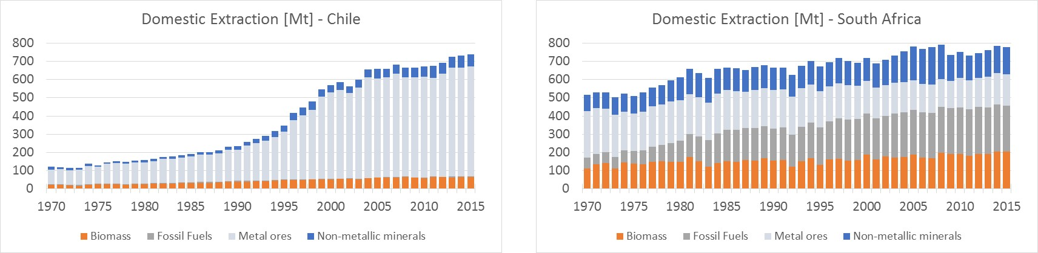
Domestic Extraction (DE)

Slide 44
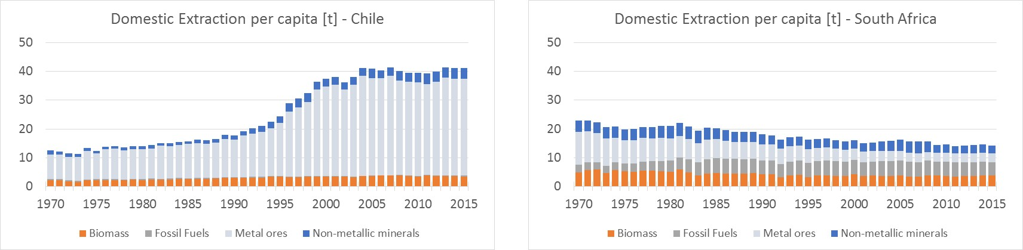
Domestic Extraction (DE/cap)

Slide 45
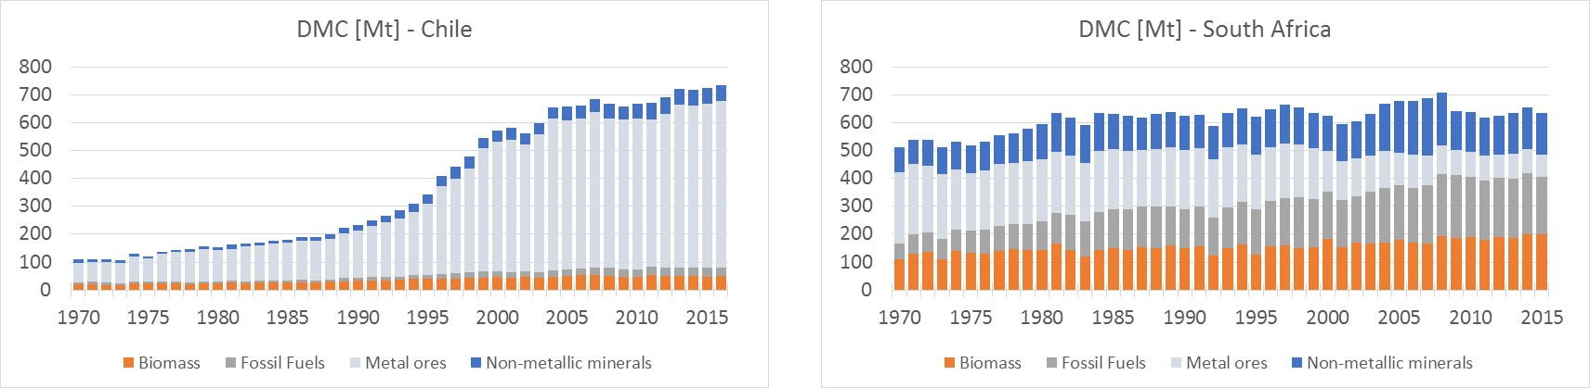
Domestic Material Consumption (DMC)

Slide 46
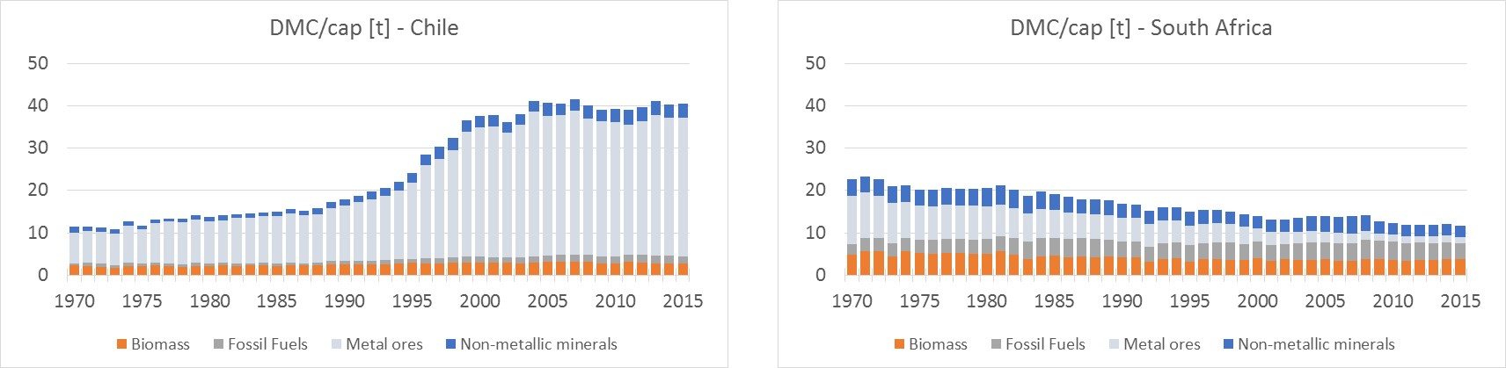
Domestic Material Consumption (DMC/cap)

Slide 47
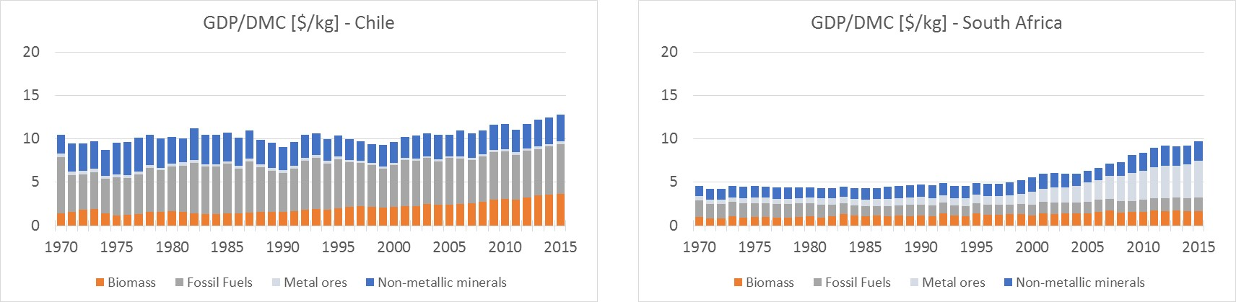
Resource Productivity (GDP/DMC)

Slide 48
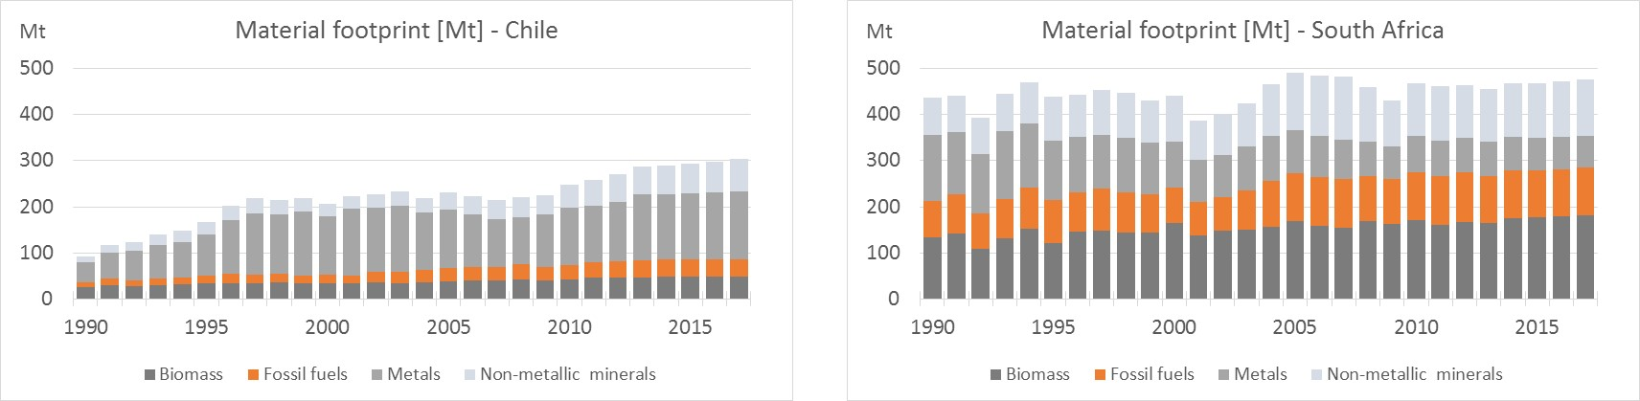
Material footprints

Slide 49
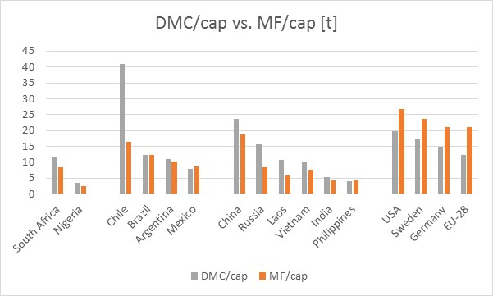
International comparison

Slide 50
Domestic Processed Outputs (DPO)

Slide 51
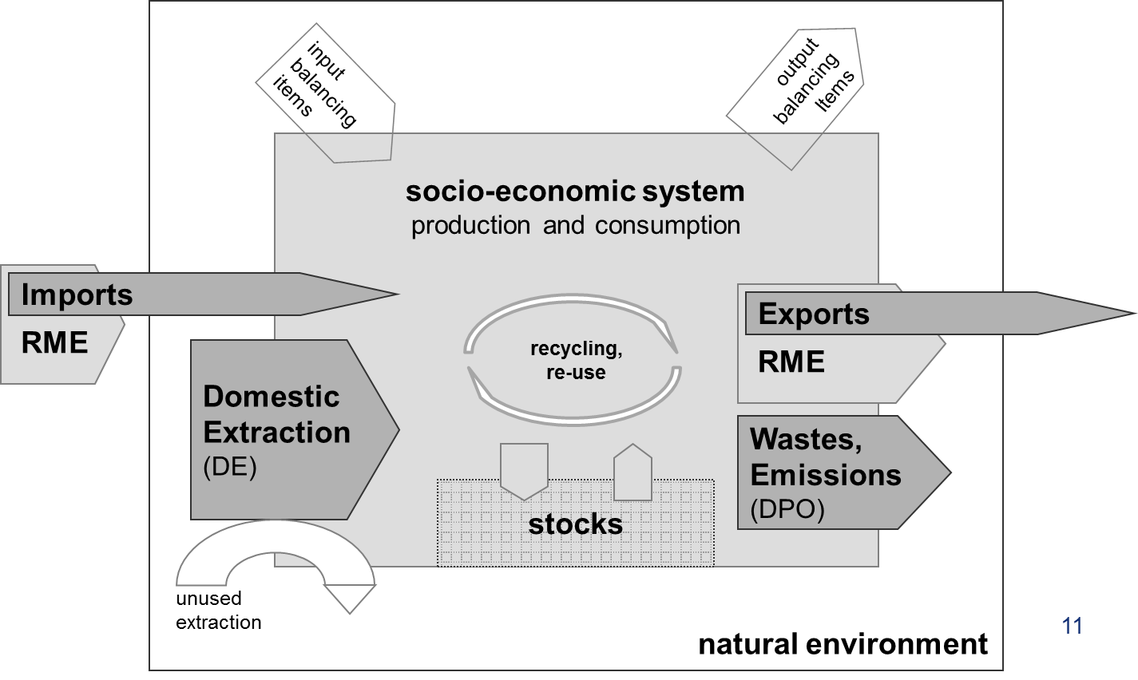
Domestic Processed Outputs (DPO)
DPO indicates the total weight of
materials, which are released back
to the environment after having
been used in the domestic economy.
DPO flows occur at the processing,
manufacturing, use, and final disposal
stages of the economic production and consumption chain.
Exported materials are not included in DPO because they are yet to be used in other countries.

Slide 52
DPO categories
Emissions to air
  CO2, CH4, N2O, NOx, HFCs, PFCs, Sulphur hexafl., CO, NMVOC, SO2, NH3, POPs, heavy metals, particles.
Waste disposal
Emissions to water
  N, P, heavy metals, other organic subst., dumping at sea
Dissipative use of products
  Fertilizers, sewage sludge, compost, pesticides, seeds, salt and other thawing material, solvents, laughing gas, etc.
Dissipative losses
  Abrasion from tires, friction products, buildings and infrastructure

Slide 53
Balancing items
Input balancing items
  Oxygen for combustion processes
  Oxygen for respiration of humans and livestock;
  bacterial respiration from solid waste and wastewater
  Nitrogen for Haber-Bosch process
  Water requirements for the domestic production of exported beverages
Output balancing items
  Water vapour from combustion
    Water vapour from moisture content of fuels
    Water vapour from the oxidised hydrogen components of fuels
  Gases from respiration of humans and livestock (CO2 and H2O), and from bacterial respiration from solid waste and wastewater (H2O)
    Carbon dioxide (CO2)
    Water vapour (H2O)
  Excorporated water from biomass products

Slide 54
Feedback and outlook to country visits
First feedback?
Open issues?
Topics of specific interest?

Slide 55
End of Webinar #2

