Slide 1
Assessment of eutrophication using satellite derived chlorophyll-a concentration in the NOWPAP region
Genki Terauchi
Email: Terauchi@npec.or.jp
Northwest Pacific Action Plan
Special Monitoring & Coastal Environmental Assessment Regional Activity Centre (NOWPAP CEARAC)

Slide 2
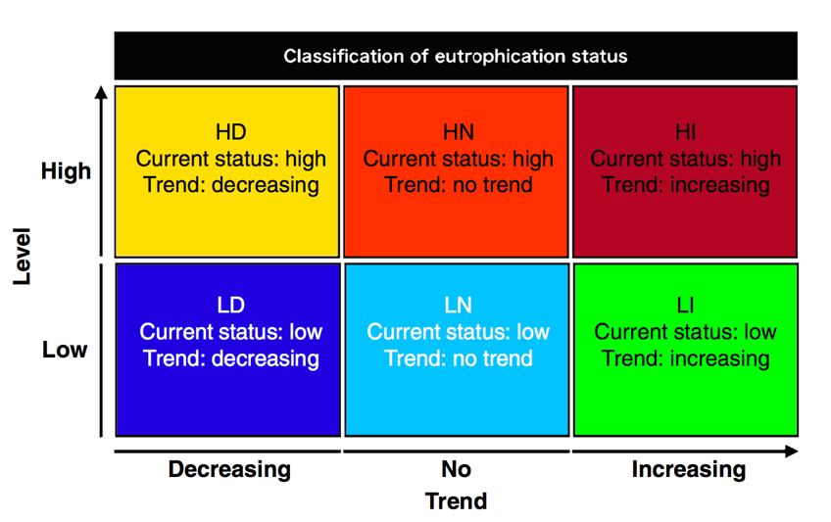
Assessment of eutrophication by the NOWPAP Common Procedure
More eutrophic
Threshold = 5 ug/L
Oligotrophic
(Less eutrophic)
Becoming oligotrophic
(less eutrophic)
Becoming eutrophic
NOWPAP CEARAC
2009, 2014)

Slide 3
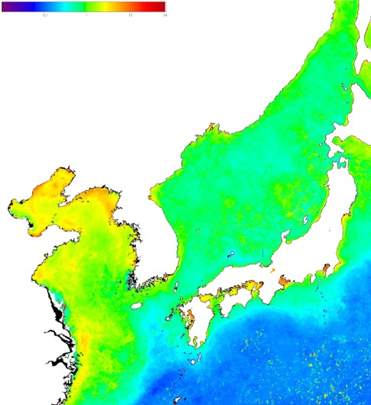
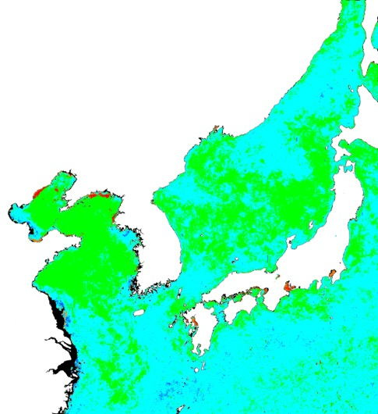
Assessment of eutrophication in the Northwest Pacific Region using satellite Chl-a from 1998 to 2015
-0.3 0 0.3 (mg m⁻³/year)
0.1 1 10 64 mg m⁻³
HD | HN | HI
LD | LN | LI
Terauchi et al (2018)

Slide 4
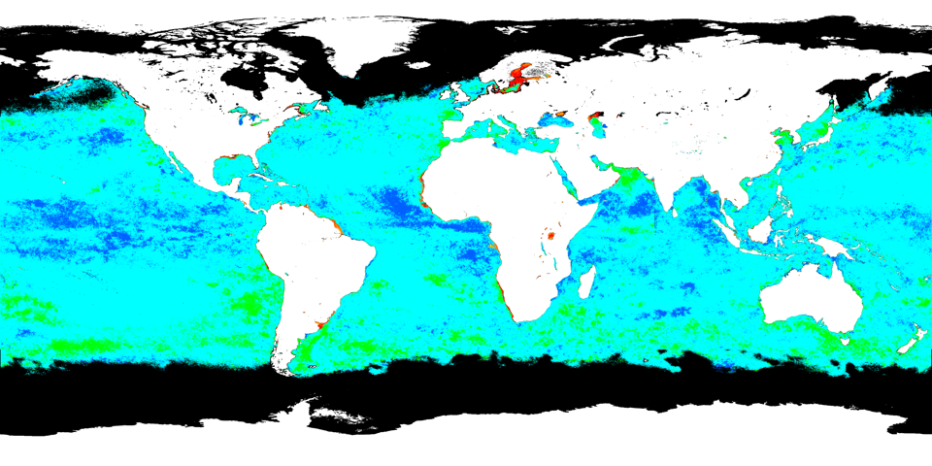
Rapid assessment of eutrophication
using satellite Chl-a from 1998 to 2017
HD | HN | HI
LD | LN | LI
G. Terauchi and E. R. Maúre (2018)
Notes:
G. Terauchi and E. R. Maúre (2018)

Slide 5
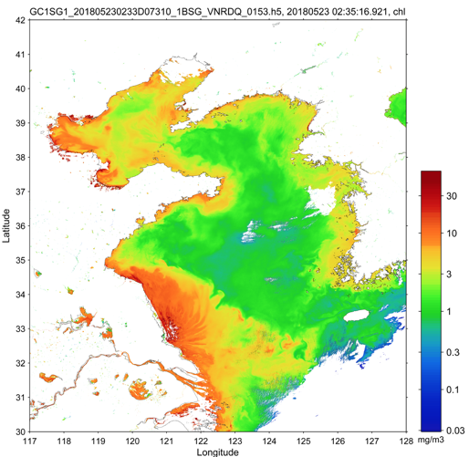
Use of SGLI of the GCOM-Mission will enhance the applicability of satellite Chl-a in eutrophication assessment in coastal zone
Chlorophyll-a concentration on May 23, 2018 observed by SGLI on board GCOM-C mission.
Image provided by Dr. Hiroshi Murakami, JAXA

